Slide 1
Part IV
Elementary Statistical Methods
Inferential Statistics

Slide 2
Elementary Statistical Methods
Chapter 8
Hypothesis Testing for a Population Mean
Slides are Made by
Tamer Oraby
UTRGV

Slide 3
8.1 Definition and Procedure
Hypothesis testing is a procedure based on sample evidence and probability used to examine a statement about a parameter (here $μ$).
It is made from 5 steps to test that the mean is either more than, less than or not equal to some given number/quantity $μ_{0}.$
Step 1:
Define the hypothesis
Null hypothesis (H₀)
Alternative hypothesis (H₁ or H_{a})
Not different than …
Different than …
H₀: $μ≤μ_{0}$
H₁: $μ>μ_{0}$
Right-sided (-tailed) test
vs
OR
H₀: $μ≥μ_{0}$
H₁: $μ<μ_{0}$
Left-sided (-tailed) test
OR
H₀: $μ=μ_{0}$
H₁: $μ≠μ_{0}$
Two-sided (-tailed) test

Slide 4
Step 2:
Level of significant $α$ (default is 0.05)
Step 3:
Given that H₀: $μ=μ_{0}$ is true, the test statistics

Slide 5
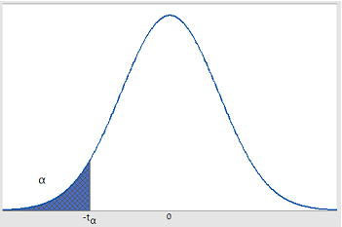
Step 4:
We calculate a probability that is called p-value or P-value that depends on the sample mean and the alternative hypothesis
p-value = P(observing such a sample mean or the more extreme when H₀ is true)
t₀
-|t₀|
|t₀|
t₀
Left-sided (-tailed) test
Two-sided (-tailed) test
Right-sided (-tailed) test

Slide 6
Recall in step 4:
p-value = P(observing such a sample mean or the more extreme when H₀ is true)
Step 5:
Decision/Conclusion:
If p-value < $α$, we reject H₀ and accept H₁.
The test is statistically significant.
The sample provides enough evidence against H₀.
If p-value > $α$, we don’t reject (we retain) H₀.
The test is not statistically significant.
The sample doesn't provide enough evidence against H₀.

Slide 7
Using Calculator TI-84 Plus
(If you are given data) Data entry
Press [STAT] key
Choose [Edit…]
Enter x into list 1 [L1]
Statistics calculations
Press [STAT] key
Choose [TESTS]
Choose option 2: [Ttest…]
Inpt: Data or Stats then enter the inputs accordingly.
Remember to keep FreqList: 1

Slide 8
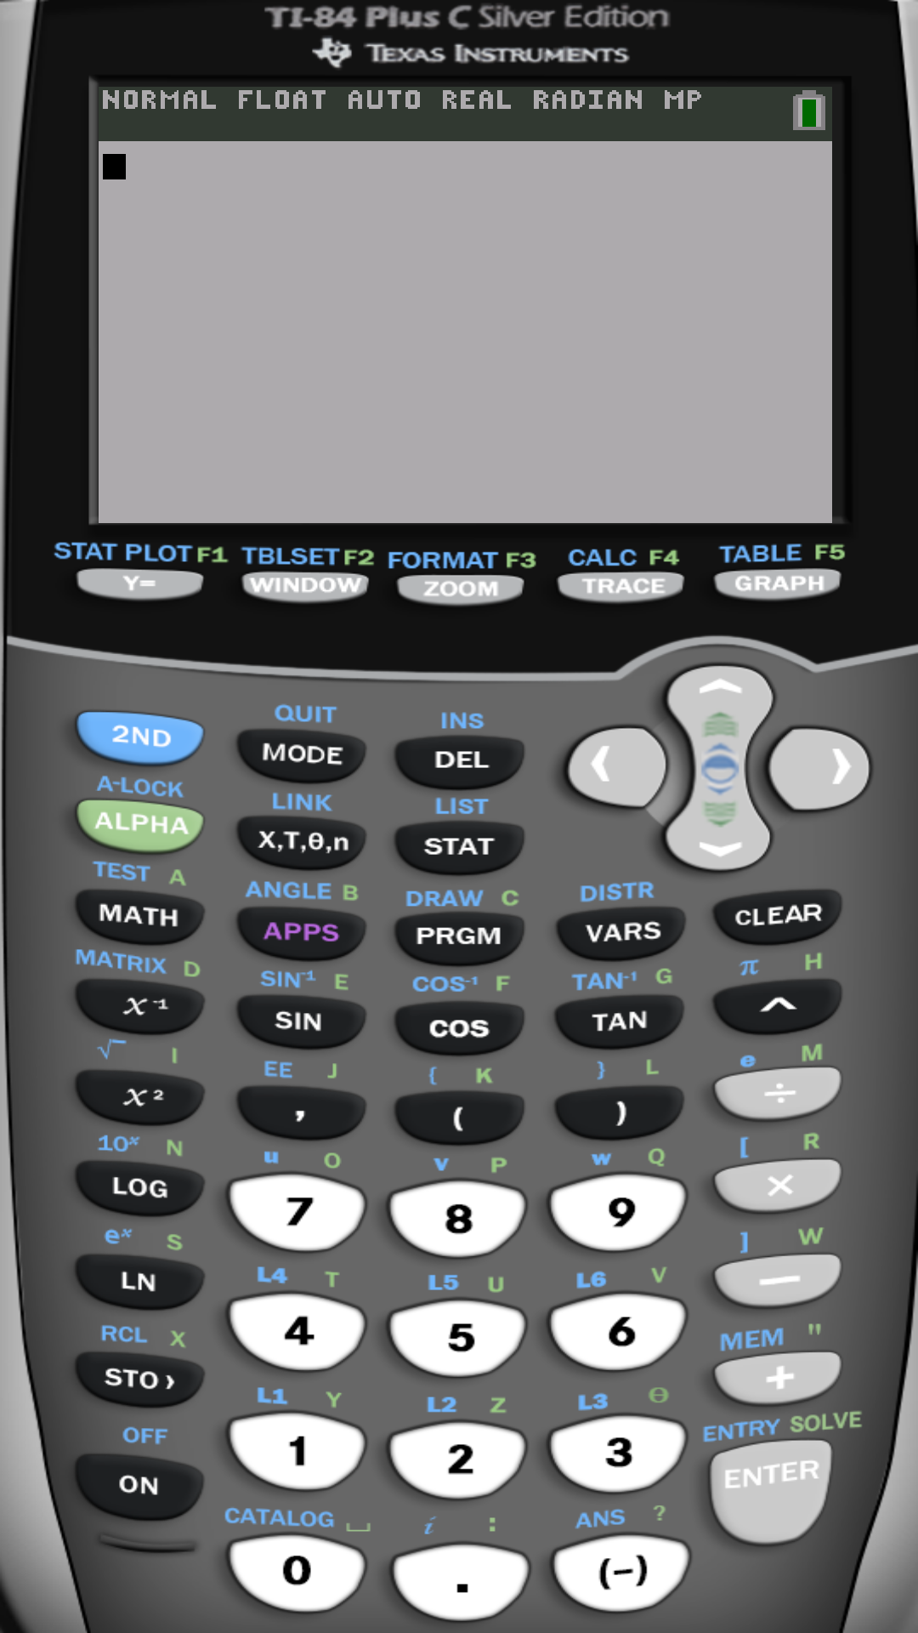
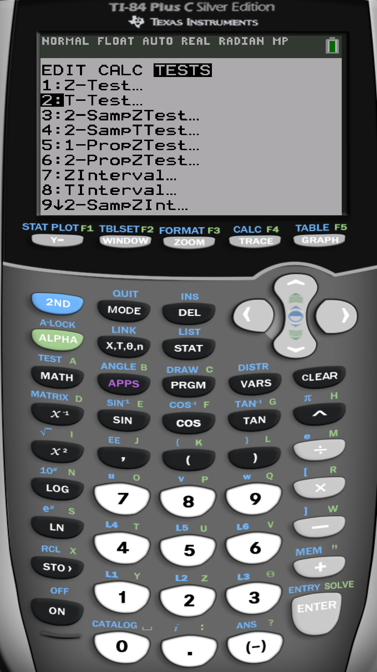

Slide 9
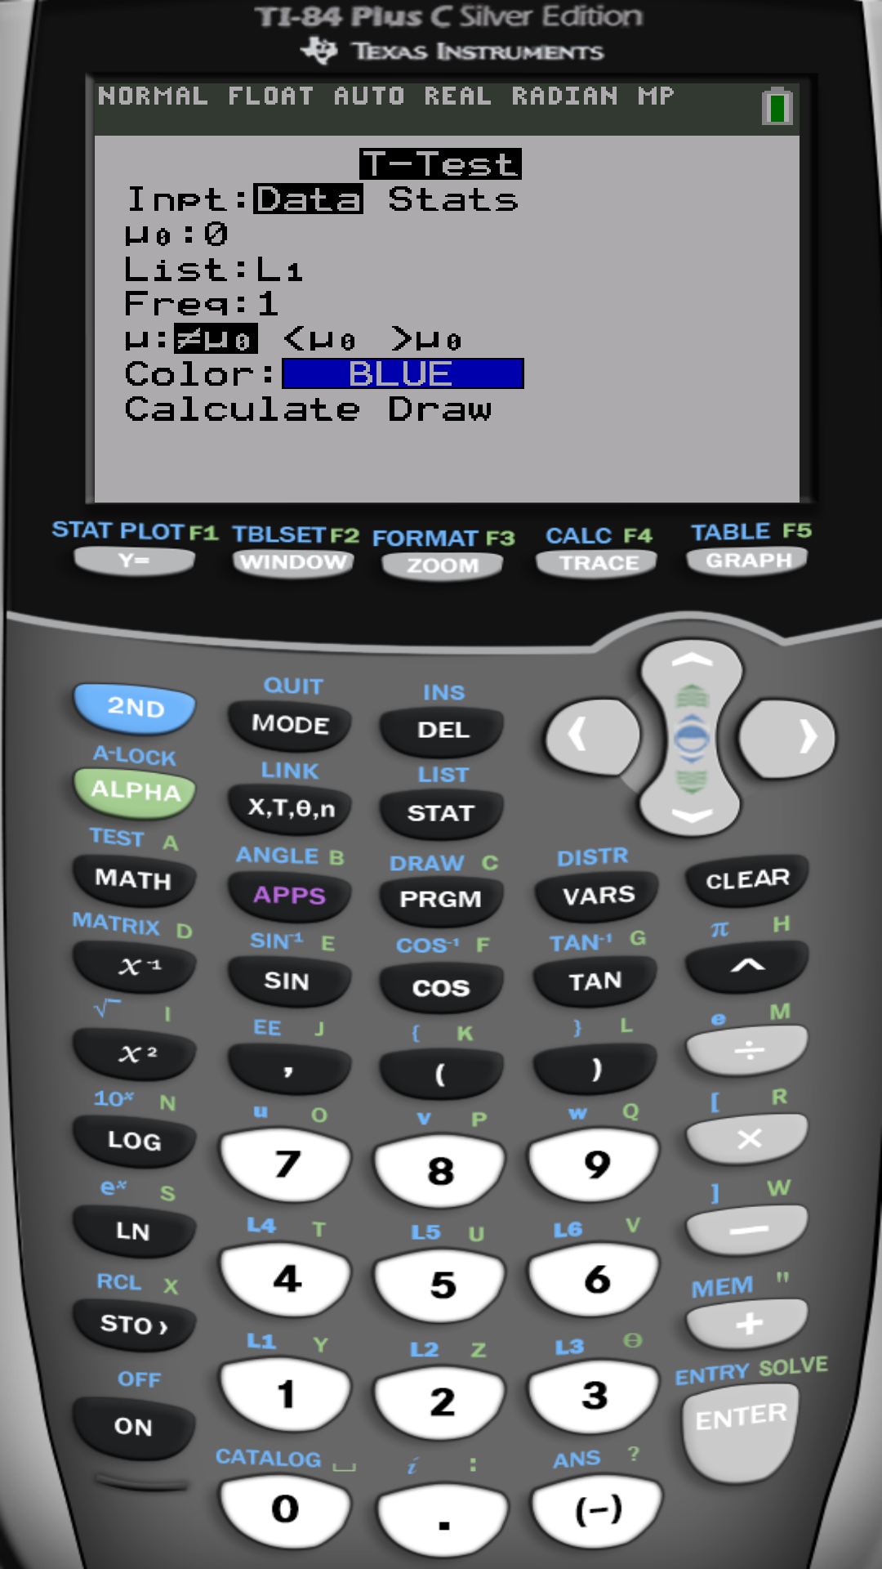
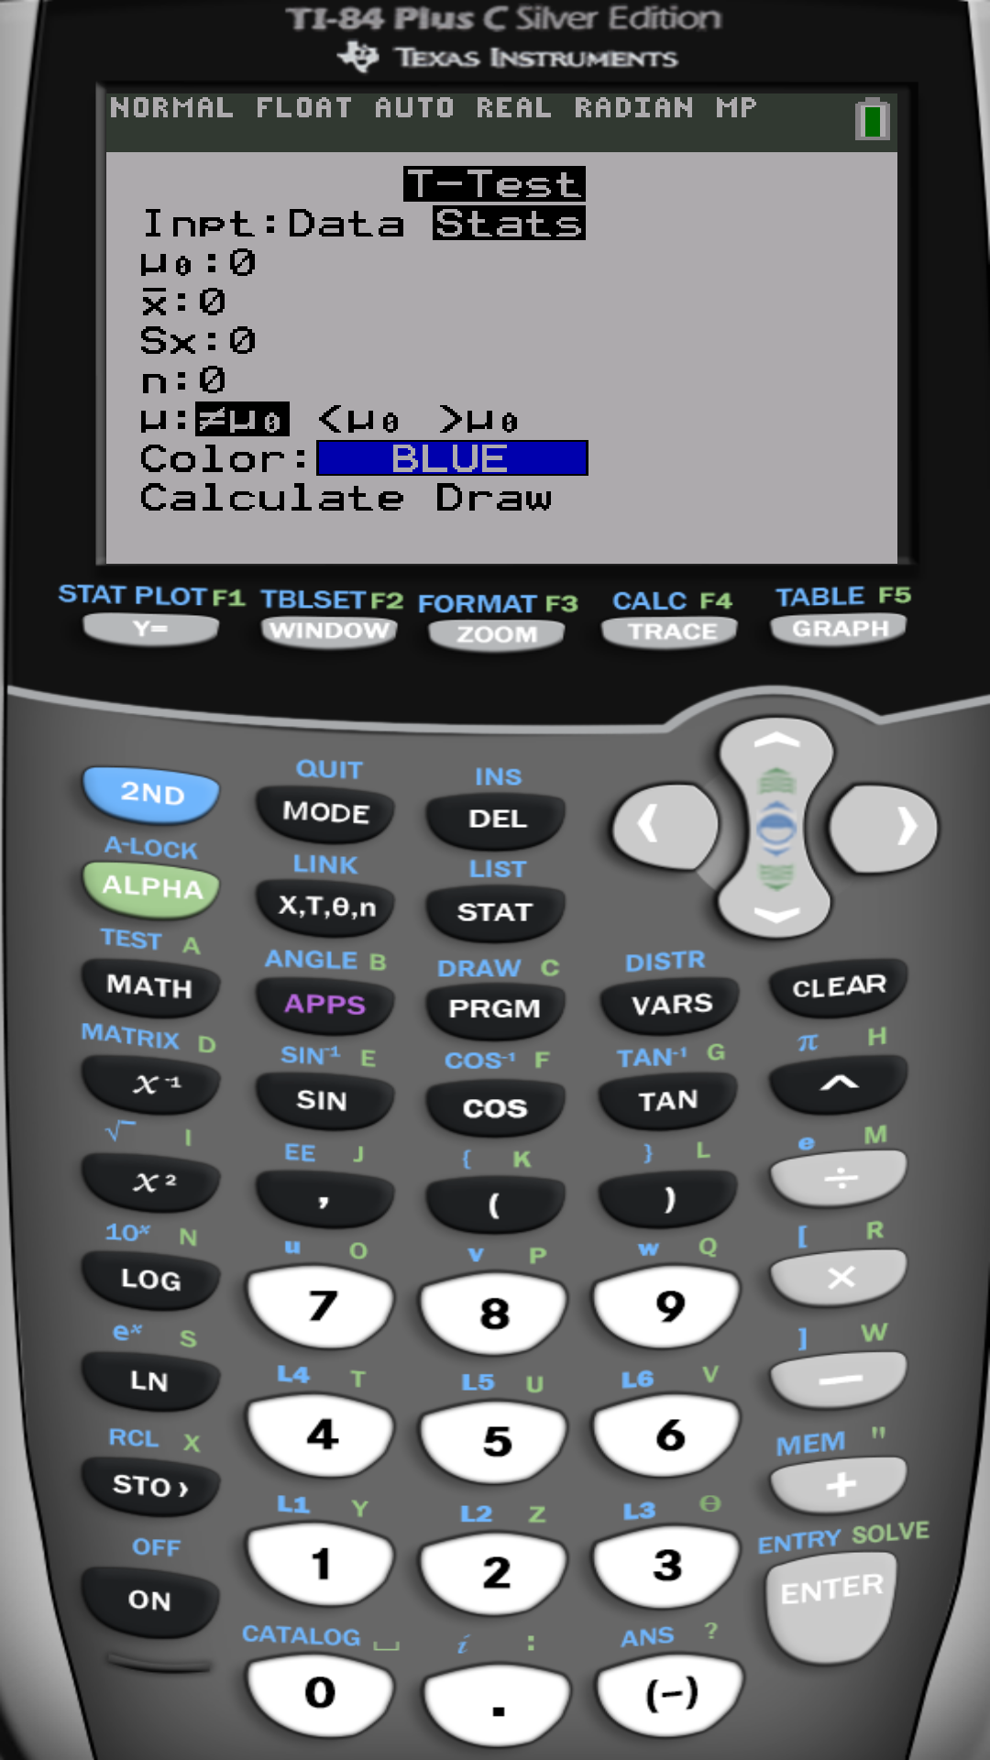

Slide 10
Example:
Calcium in Rainwater Calcium is essential to tree growth because it promotes the formation of wood and maintains cell walls. In 1990, the concentration of calcium in precipitation in Chautauqua, New York, was 0.11 milligram per liter(mg/L). A random sample of 10 precipitation dates in 2010 results in the following data. Perform a two-tailed test to see if it
changed.
0.065 | 0.087 | 0.070 | 0.262 | 0.126
0.183 | 0.120 | 0.234 | 0.313 | 0.108
Step 1:
Step 2:
$$α = 0.05$$

Slide 11
Step 3:
Test Statistics
Step 4:
P-value = 0.122
Step 5:
P-value > $α$
-1.7073
1.7073
Don’t reject H₀
The data doesn’t give enough evidence to indicate that the calcium concentration have changed since 1990.

Slide 12
Example:
Effects of Alcohol on the brain In a study published in the American journal of psychiatry (157:737-744, May 2000), researchers wanted to measure the effect of alcohol on the development of the hippocampal region in adolescents. The hippocampus is the portion of the brain responsible for long-term memory storage. The researchers randomly selected 12 adolescents with alcohol use disorders. They wanted to determine whether the hippocampal volumes in alcoholic adolescents were less than the normal volume of 9.02 cm³. An analysis of the sample data revealed that the hippocampal volume is approximately normal with $\overline{x}=8.1$ cm³ and s=.7 cm³. Conduct the appropriate test at the 0.01 level of significance.
Step 1:
Step 2:
$$α = 0.01$$

Slide 13
Step 3:
Test Statistics
Step 4:
P-value = 4.13*10⁻⁴
= .000413
- 4.55
Step 5:
P-value < $α$
Reject H₀ and accept H₁
The data provides evidence that the mean size of hippocampus in adolescent with alcohol disorder is less than normal adolescent.

Slide 14
Example:
Waiting in line The mean waiting time at the drive through of a fast food restaurant from the time an order is placed to the time the order received is 84.3 seconds. A manager devises a new drive trough system that he believes will decrease wait time. He initiates the new system at his restaurant and measures the wait time for 10 randomly selected orders. The wait times are provided in the table
108.5 | 67.4 | 58.0 | 75.9 | 65.1
80.4 | 95.5 | 86.3 | 70.9 | 72.0
Step 1:
Step 2:
$$α = 0.05$$

Slide 15
Step 3:
Test Statistics
Step 4:
P-value = 0.1112
- 1.31
Step 5:
P-value > $α$
Don’t reject H₀
The data doesn’t provide enough support to the manager's belief that the new system decrease the mean waiting time.

Slide 16
The “Court” metaphor
(Attorney) H₀: defendant is not guilty (innocent)
VS
(Prosecutor) H₁: defendant is guilty
Jury looks at the available evidence (sample data) then:
if it is observed such an evidence against the defendant when H₀ is true, the jury’s verdict is
Reject H₀→ Accept H₁ … that is the defendant is guilty, or
if the evidence is not enough to reject H₀, the jury’s verdict is
Don’t not reject H₀ … that the defendant is not guilty.

Slide 17
Types of errors committed when testing hypothesis
Fact Conclusion | H₀ is true (not guilty, not infected) | H_{a} is true (guilty, infected)
Reject H₀ | Type I error P(Type I) = $α$ (False-positive) | Power = $1−β$ (Sensitivity)
Don’t Reject H₀ | (Specificity=$1−α$) | Type II error P(Type II) = $β$ (False-negative)
The three quantities: $n$, $α$and $β$ are in 3-way tug-o-war:
Fix $n:$ as $α$increases, $β$ decreases and vice versa
Fix $α:$ as n increases, $β$ decreases and vice versa
Fix $β:$ as n increases, $α$decreases and vice versa

Slide 18
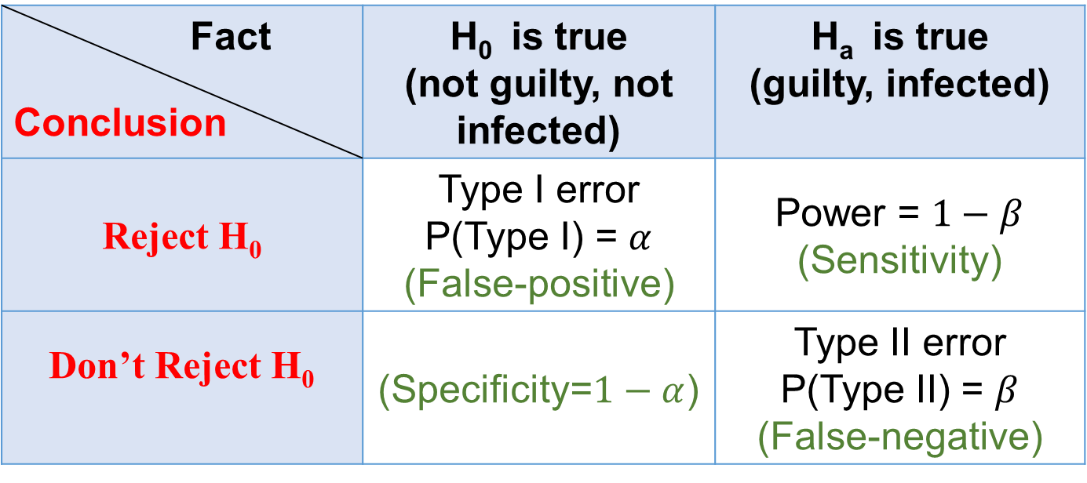
Example:
Fair Packaging and Labeling Federal law requires that a jar of peanut butter that is labeled as containing 32 ounces must contain at least 32 ounces. A consumer advocate feels that a certain peanut butter manufacturer is shorting customers by under filling the jars.
a) State the null and alternative hypotheses
b) What does it mean to commit type I error?
To make a type I error is to reject the manufacturer's claim that the weight is 32 ounces, while it is true.
c) What does it mean to commit type II error?
To make a type II error is to not rejecting manufacturer's claim that the weight is 32 ounces, while it is wrong.

Slide 19
Example:
Cell phone services According to the CTIA- The Wireless Association, the mean monthly cell phone bill was $47.47 in 2010. A researcher suspects that the mean monthly cell phone bill is different today.
a) State the null and alternative hypotheses
b) What does it mean to commit type I error?
To make a type I error is to reject the CTIA's claim that the mean monthly bill is $47.47, while it is true.
c) What does it mean to commit type II error?
To make a type II error is to not rejecting CTIA's claim that the mean monthly bill is $47.47, while it is wrong.

Slide 20
Example :
Test Preparation The mean score on the SAT Math Reasoning exam is 516. A test preparation company states that the mean score of students who take its course is higher than 516.
(a) Determine the null and alternative hypothesis.
(b) If sample data indicate that the null hypothesis should not be rejected, state the conclusion of the company
The data doesn’t provide enough evidence to (reject $μ=516$) or to support the claim that the mean score of SAT Math is higher than 516.

Slide 21
(c) Suppose, in fact, that the mean score of students taking the preparatory course is 522. Has a type I or type II error been made? If we tested this hypothesis at $α = 0.01$level, what is the probability of committing a type I error?
Since H₁ is true but we failed to reject H₀ then it is Type II error.
P(Type I error) = $α$ = 0.01
(d) If we wanted to decrease the probability of making a Type II error, would we need to increase or decrease the level of significance?
Increase the level of significance $α$.

Slide 22
Using the statistical software R
R is a free professional statistical software
Download and install for free from
https://www.r-project.org/
Free on-line R compiler
http://rextester.com/l/r_online_compiler

Slide 23
Example: Test the hypothesis that the population mean is 20 using the SRS of size n= 24, given below. Make sure to check up the conditions of normality of the population since n<30.
# Enter the variable into R
sam=c(18.1,15.4,18.4,19.7,18.3,20.6,21.1,18.1,19.6,17.2,18.4,16.7,20.2,16.6,17.2,18.3,18.9,17.4,17.2,16.5,19.3,19.6,19.2,20.9)
# To check up normality
qqnorm(sam)
qqline(sam)
hist(sam)

Slide 24
# to perform two-sided test (default) with H₀:$μ$=20 vs H_{a}: $μ≠$ 20 and find C.I.
t.test(sam, mu=20)
# to perform left-sided test with H₀: $μ$= 20 vs H_{a}: $μ$< 20 and upper limit C.I.
t.test(sam, mu=20, alternative="less")
# to perform right-sided test with H₀: $μ$= 20 vs H_{a}: $μ$>20 and lower limit C.I.
t.test(sam, mu=20, alternative="greater")

Slide 25
End of Chapter 8

